Slide 1
2. Robot Dynamics
2.1 Newton-Euler formulations
2.2 Lagrange-Euler formulation
2.3 Properties of Dynamic Model
2.4 Dynamics Tutorials
2.5 Neural Network Modelling
- 1 -

Slide 2
2.5 Neural Network Modelling
Neural Network Approximations
Neural Network Modelling of Robots
Function Approximation
Linearly Parametrized Neural Networks
Non-linearly Parametrized Neural Networks
Ge-Lee (GL) Matrix and Operator
- 2 -

Slide 3
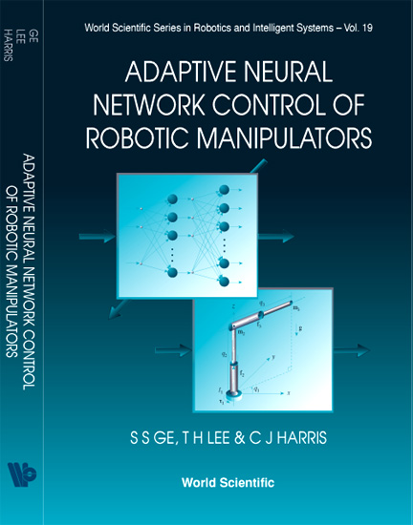
2.5 Neural Network Modelling
To obtain the dynamics of higher degrees of freedom manipulator as
are very simple in its representation but are very difficult, time consuming and error prone to obtain except for simple cases.
It is desirable to have generic non-linear model structures for dynamic modelling, such neural network modeling.
S. S. Ge, T. H. Lee, and C. J. Harris. Adaptive neural network control of robotic manipulators. Vol. 19. World Scientific, 1998.
- 3 -

Slide 4
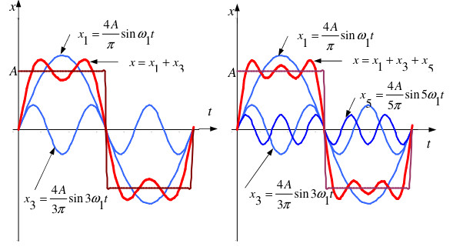
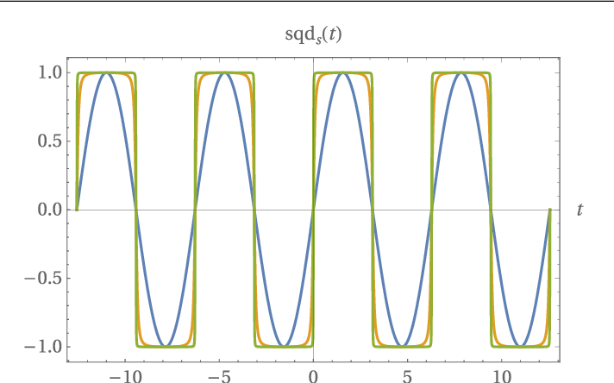
2.5 Neural Network Modelling
Square Wave Approximation
Here you go:

Slide 5
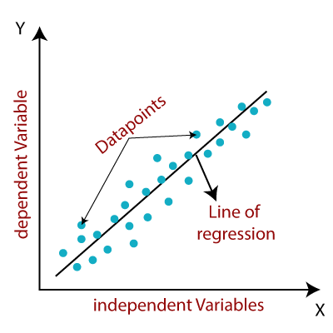
Linear Approximation
2.5 Neural Network Modelling
1. Linear regression
A linear regression line has an equation of the form:
independent variable
dependent variable
slope of the line
intercept

Slide 6
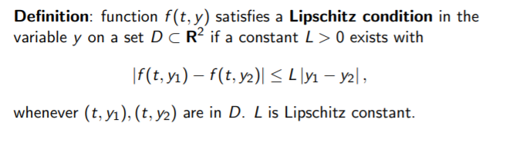
Smooth Lipschitz Function Approximation
2.5 Neural Network Modelling
2. Lipschitz continuous function
Approximation by Smooth Lipschitz Functions

Slide 7
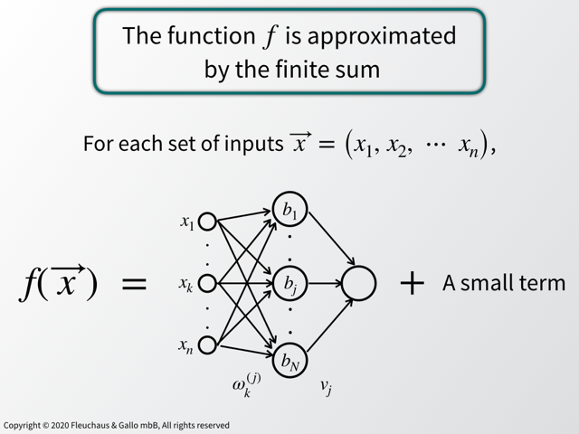
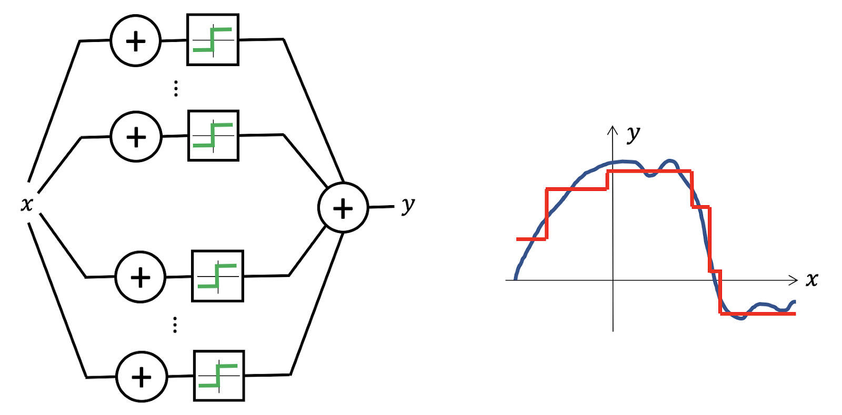
Neural Network Approximation
2.5 Neural Network Modelling
3. Universal approximation theorem
The Universal Approximation Theorem tells us that Neural Networks has a kind of universality i.e. no matter what f(x) is, there is a network that can approximately approach the result and do the job!

Slide 8
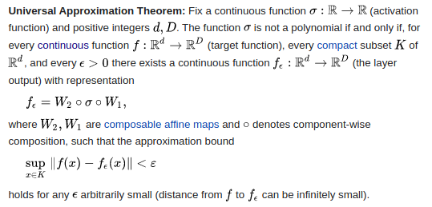
2.5 Neural Network Modelling
https://ml.berkeley.edu/blog/posts/uat/

Slide 9
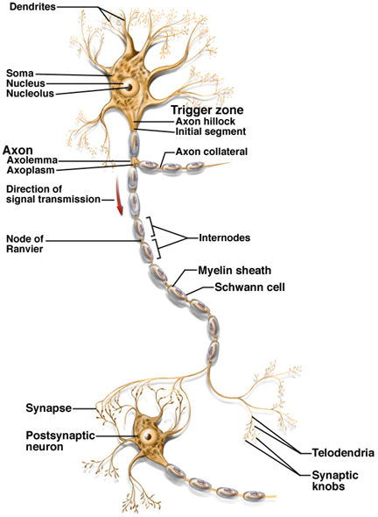
2.5 Neural Network Modelling
Biological Neuron
A typical biological neuron is composed of:
A cell body;
A tubular axon: a long thin tube that splits into branches terminating in little end bulbs that almost touch the dendrites of other cells;
A multitude of hair-like dendrites that form a very fine filamentary brush surrounding the body of the neuron;

Slide 10
2.5 Neural Network Modelling
Synapses:
Small gap between an end bulb and a dendrite.
Basic structural and functional units that mediate the interactions between neurons.
Can impose excitation (active) or inhibition (inactive) on the receptive neurons.
Dendrites
Nucleus
Cell body
Axon
Synapses (from other neurons)
Synapses (to other neurons)
Dendrites (of other neurons)

Slide 11
AI Neural Networks
2.5 Neural Network Modelling
number of input data
{ x_{1,} x_{2,…} x_{n}}
x₁
b_{k}
(bias)
w_{k1}
x₂
w_{k2}
+1
w_{k3}
u_{k}
x₃
Output y_{k}
Inputs
w_{k4}
Activation
function
x₄
w_{km}
x_{m}
Synaptic weights
dimension of input data

Slide 12
2.5 Neural Network Modelling
Neural networks (NNs) consist of a large number of simple processing elements called nodes.
The nodes are interconnected by weighted links where the weights are the network’s adjustable parameters.
In control engineering, a neural network is usually used to generate input/output maps using the property that a multi-layer neural network can approximate any function, under mild assumptions, with any desired accuracy.
- 12 -

Slide 13
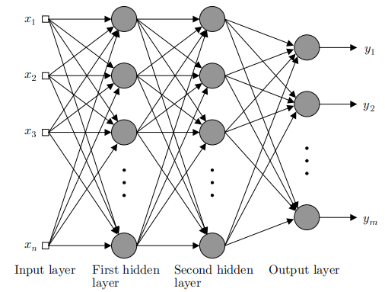
2.5 Neural Network Modelling
Multi-Layer Perceptron (MLP) Network
- 13 -

Slide 14
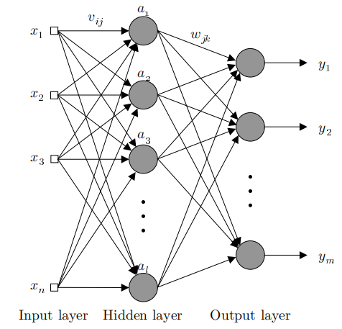
2.5 Neural Network Modelling
Linearly Parametrized Neural Networks: are the NNs in which the adjustable parameters appear linearly.
The output of the hidden layer
The output of the network
The RBF networks belong to a class of Linear Parametrized Neural Networks
Three layer neural network
- 14 -

Slide 15
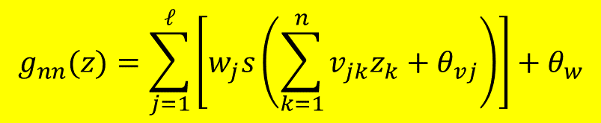
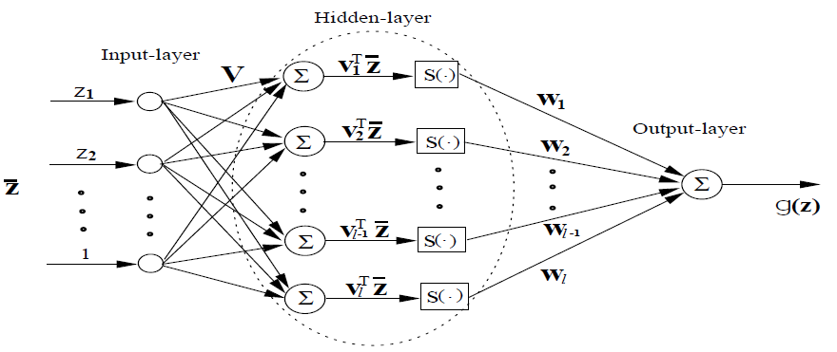
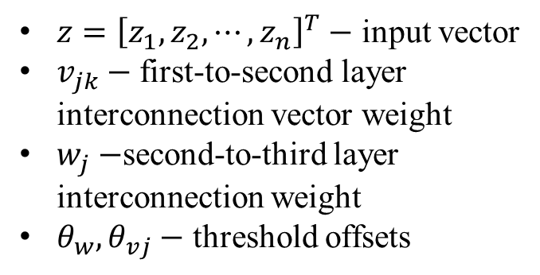
2.5 Neural Network Modelling
Non-linearly Parametrized Neural Networks: are the NNs in which the adjustable parameters appear nonlinearly.
General nonlinear activation function:
sigmod:
tanh:
ReLU:
- 15 -

Slide 16
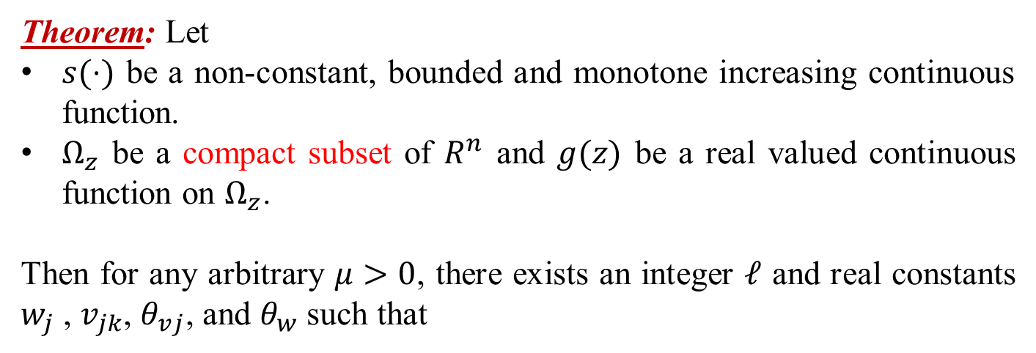
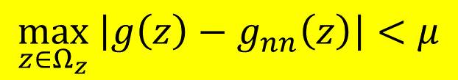
2.5 Neural Network Modelling
Non-linearly Parametrized Neural Networks
- 16 -

Slide 17
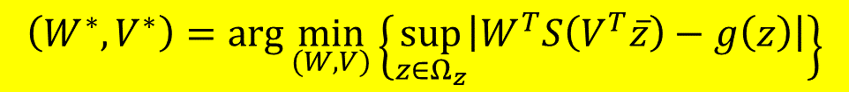
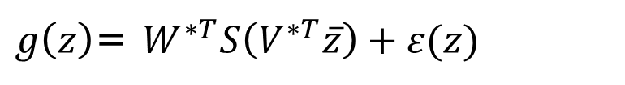


2.5 Neural Network Modelling
According to Theorem, there exist ideal constants W* and V* such that
$$\max_{z∈Ω_{z}}\left|g\left(z\right)−g_{nn}(W^{∗},V^{∗},z)\right|<μ≤\overline{μ}$$
with constant $\overline{μ} >0$for all $Z∈Ω_{z}$. That is,
$g\left(z\right)$= $W^{∗T}S\left(V^{∗T}\overline{z}\right)+ε(z)$
with $ε(z)$ satisfying $\max_{z∈Ω_{z}}\left|ε(z)\right|<μ$, $∀z∈Ω_{z}$.
The ideal weights satisfying the above approximation are not unique. To avoid confusion, the ideal weights W* and V* are defined as

Slide 18
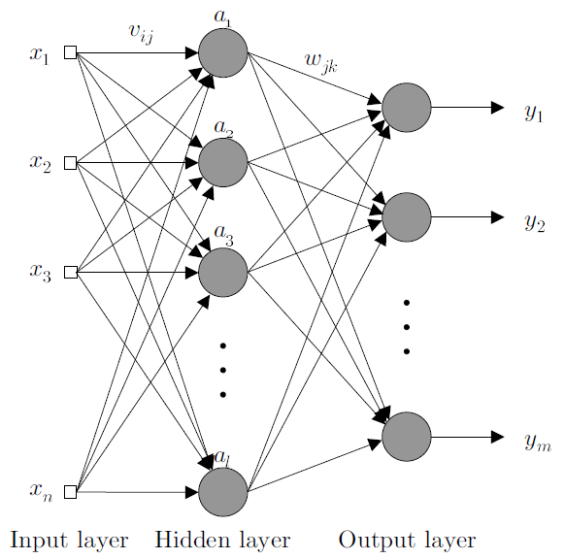

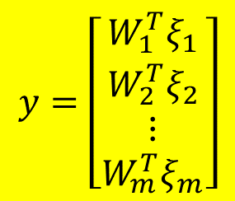
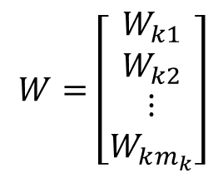
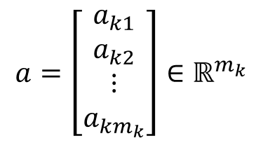

2.5 Neural Network Modelling
GL (General-Leeway) Matrix and Operator
The output network is expressed as
(1)
Another representation is
(2)
where
- 18 -

Slide 19
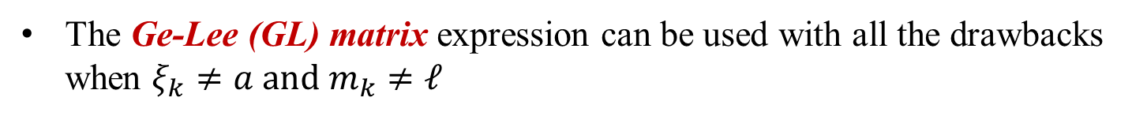
2.5 Neural Network Modelling
GL (General-Leeway) Matrix and Operator
(1)
(2)
- 19 -

Slide 20
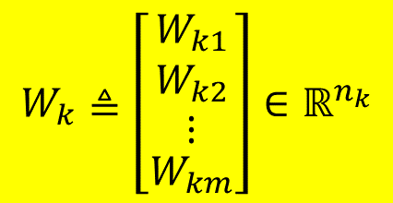

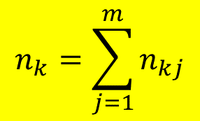


2.5 Neural Network Modelling
GL (General-Leeway) Matrix and Operator
Let
Define
where
- 20 -

Slide 21
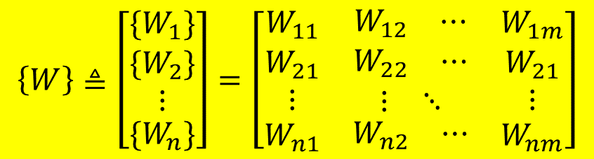
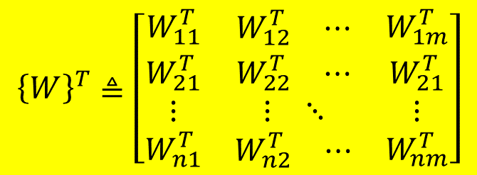

2.5 Neural Network Modelling
GL Matrix and Operator
The detailed formulations of {W} and {W}^{T} are given by
- 21 -

Slide 22
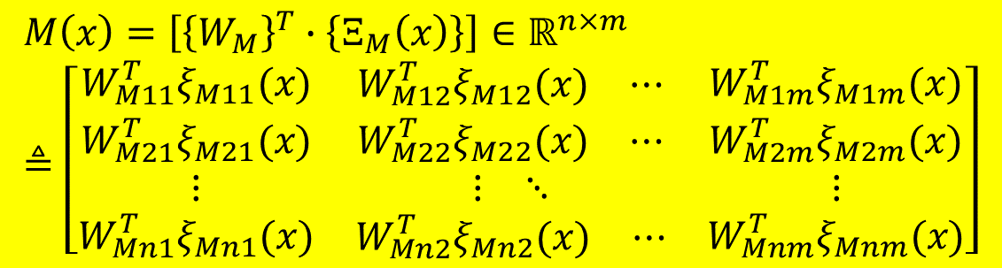
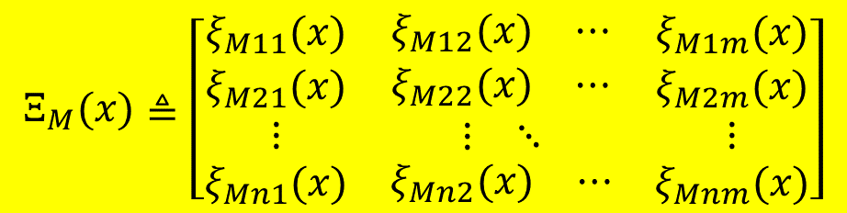
2.5 Neural Network Modelling
GL Matrix and Operator
where
- 22 -

Slide 23



2.5 Neural Network Modelling
GL Matrix and Operator: Properties
The definition of transpose for GL matrix (vector) is different from that of conventional matrix (vector). It only transpose its elementary vectors locally.
The transpose of a GL row vector equals the transpose of the corresponding conventional vector. For example, .
A conventional matrix (vector) can be taken as a GL matrix (vector) by grouping the elements of the matrix (vector) into sub-vectors accordingly.
The GL product of two GL matrices (or two GL vectors) leads to a conventional matrix (or a vector). For example, and .
- 23 -

Slide 24

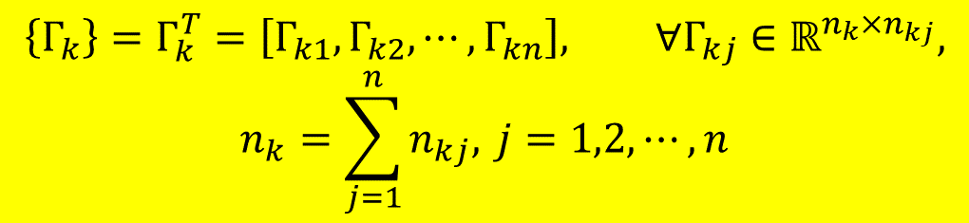
2.5 Neural Network Modelling
Let a GL row vector
Def: The GL product of a square matrix and a GL row vector is defined as
- 24 -

Slide 25
2.5 Neural Network Modelling
Note:
The GL product should be computed first in a mixed matrix product.
The GL matrix and operator will be used in the control design later.
Example:
Compute {A}•{B}C
matrix [{A}•{B}] should be computed first to get a conventional matrix [{A}•{B}].
[{A}•{B}]C is computed.
- 25 -

Slide 26

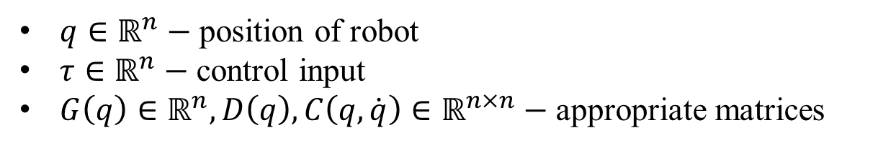
2.5 Neural Network Modelling
Neural Network Modelling of Robots
The dynamics of a robot are function of position, velocity and acceleration, and can be described by following Lagrange-Euler equation.
- 26 -

Slide 27
2.5 Neural Network Modelling
Neural Network Modelling of Robots
NNs have been used to approximate the complete non-linear dynamics as follows
It can be seen that the NNs are functions of , and .
Because of the difficulty in measuring acceleration for system identification and control system design, the format in the above equation has been losing ground to the NN models in which NNs are used to approximate different functions selectively for the convenience of controller design.
- 27 -

Slide 28
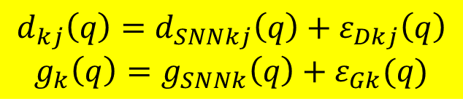
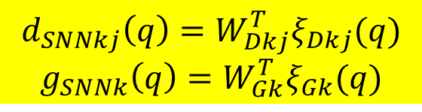
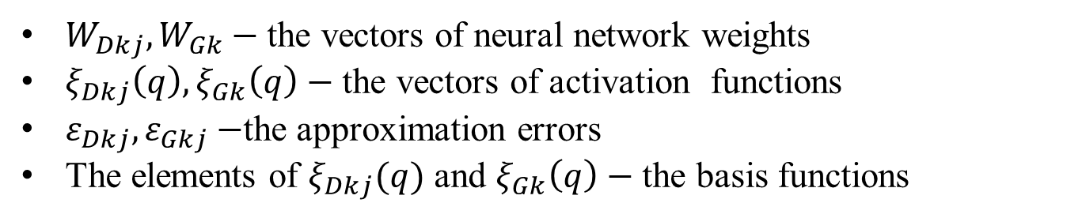
2.5 Neural Network Modelling
Neural Network Modelling of Robots
The elements of D(q) and G(q), i.e. d_{kj}(q) and g_{k}(q) respectively are functions of q only. Thus, static neural networks (SNN), whose inputs are q only, are sufficient to model them. Suppose
where
- 28 -

Slide 29
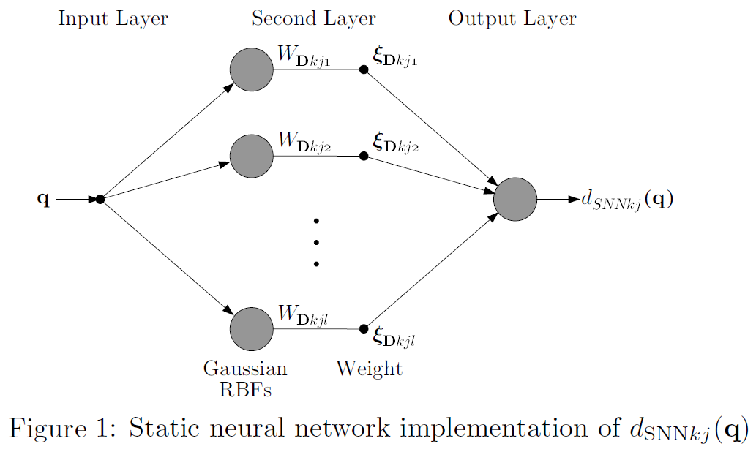
2.5 Neural Network Modelling
Neural Network Modelling of Robots
- 29 -

Slide 30
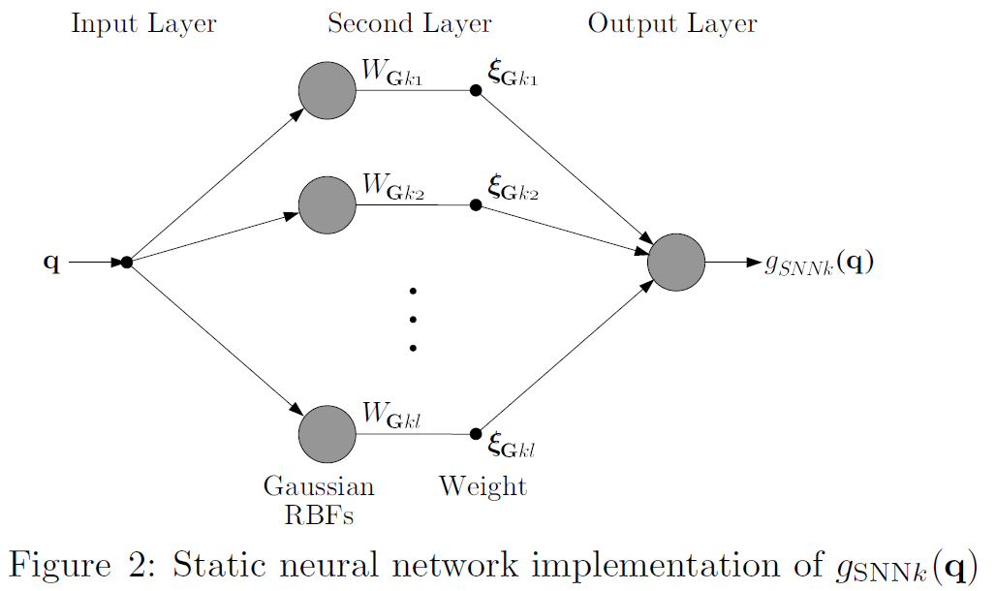
2.5 Neural Network Modelling
Neural Network Modelling of Robots
- 30 -

Slide 31


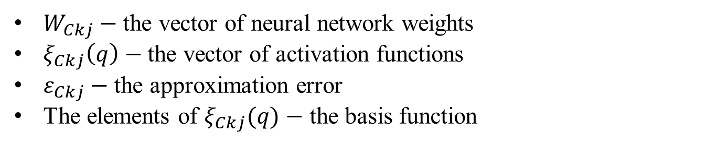
2.5 Neural Network Modelling
Neural Network Modelling of Robots
, is a function of both q and . Therefore, dynamic neural networks (DNN) of q and are necessary.
The dynamic neural network emulator of is given by
Then
- 31 -

Slide 32
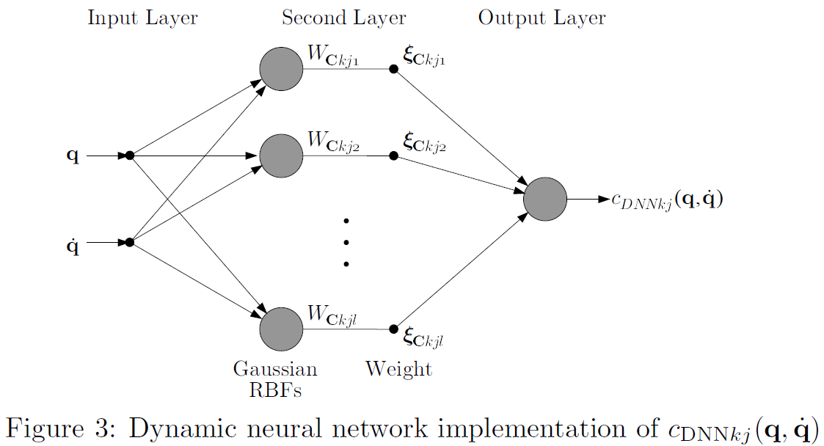
2.5 Neural Network Modelling
Neural Network Modelling of Robots
- 32 -

Slide 33

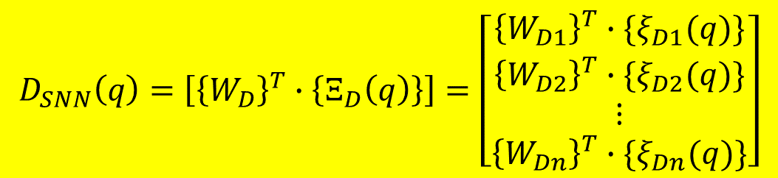
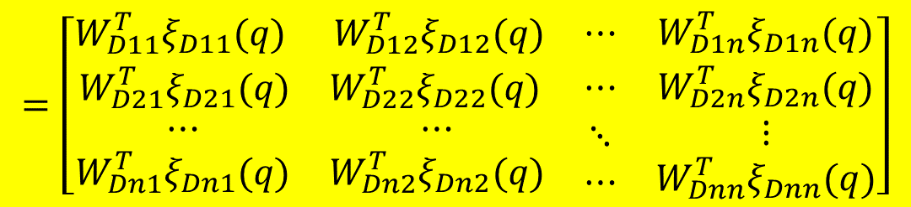
2.5 Neural Network Modelling
Neural Network Modelling of Robots
Based on the definitions for GL matrix and operator, we have
where
- 33 -

Slide 34
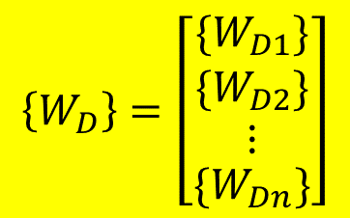
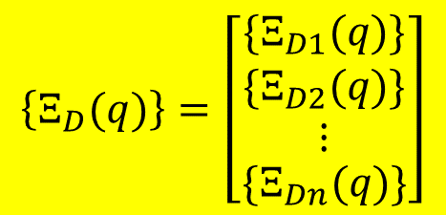


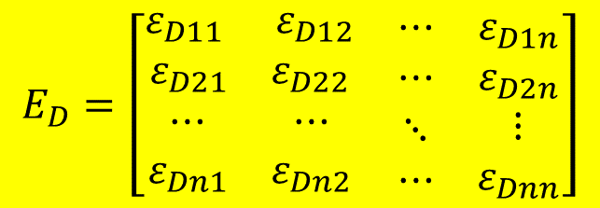
2.5 Neural Network Modelling
Neural Network Modelling of Robots
with
and
- 34 -

Slide 35


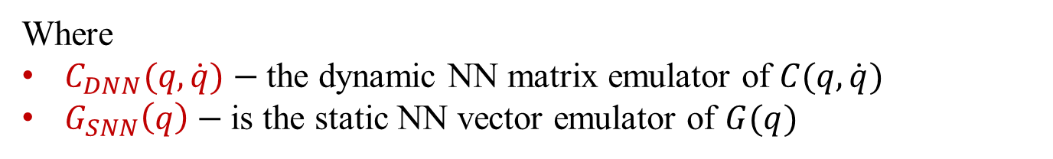

2.5 Neural Network Modelling
Neural Network Modelling of Robots
Similarly, we have
where
- 35 -

Slide 36
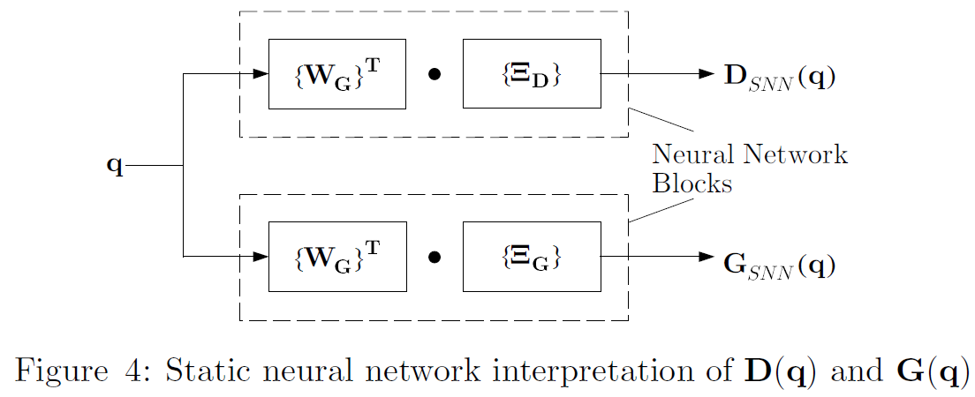
2.5 Neural Network Modelling
Neural Network Modelling of Robots
The neural network approximations of D(q) and G(q) are schematically shown in the following figure.
- 36 -

Slide 37

2.5 Neural Network Modelling
Neural Network Modelling of Robots
Finally, the dynamic neural network model can be obtained as
$$D_{SNN}\left(q\right)\ddot{q}+C_{DSS}\left(q,\dot{q}\right)\dot{q}+G_{SNN}\left(q\right)+E_{D1}=τ$$
$$E_{D1}=E_{D}\ddot{q}+E_{C}\dot{q}+E_{G}$$
Dynamic NN Model D – 1
Dynamic NN model D – 2, Static NN models can be found in chapter 4 in Reference [1]
- 37 -

Slide 38
2.5 Neural Network Modelling
Neural Network Modelling of Task Space Dynamics
The above dynamic neural network modelling method can be directly applied to neural network modelling of robot dynamics in Cartesian space.
Corresponding to the joint space dynamics, the task space dynamics are given by
where
- 38 -

Slide 39
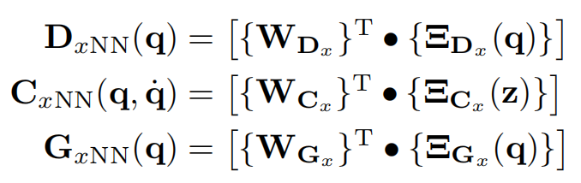
2.5 Neural Network Modelling
Neural Network Modelling of Task Space Dynamics
The Cartesian space NN dynamics of robots can thus be described as
where
- 39 -

